Slide 1

22PHY106: Computational Physics 2023
Project Presentation
Design and development of Plastic PYROLYSIS
Supervised by: Dr.Akhil Mohan
ASSISTANT Professor SHOOL of Artificial Intelligence Amrita Vishwa Vidyapeetham

Slide 2
Team MEMBERS
1. SANGGIT SAARAN K C S CB.SC.U4AIE23247
2. K S VENKATRAM CB.SC.U4AIE23236
3. VISHAL SESHADRI B CB.SC.U4AIE23260
4. SURYA HA CB.SC.U4AIE23267
5. HARIVAARTHAN TD CB.SC.U4AIE23228

Slide 3
CONTENTS
ABSTRACT
OBJECTIVE
PLASTIC PYROLYSIS
PROCESSFLOW DIAGRAM
DOUBLE CONDENSER
AND IT’S FEATURES
REACTOR CONSTRUCTION
MATERIALS/APPARATUS used
TIMELINE
KEY STEPS IN PYROLYSIS
WORKING MECHANISM
FEEDSTOCK AND IT’S CHARACTERISTICS
PYROLYSIS KINETICS
FUTURE ENHANCEMENTS
CONCLUSION
ECONOMIC AND ENVIRONMENTAL IMPACT
ADVANTAGES AND DISADVANTAGES OF PYROLYSIS

Slide 4
ABSTRACT
The accumulation of vast amounts of plastic waste worldwide poses significant environmental challenges. However, pyrolysis, a process that involves converting plastic waste into valuable hydrocarbons, can play a crucial role in addressing this issue. These hydrocarbons can be utilized as fuels or as raw materials in the petrochemical industry, offering economic benefits.
Plastics have become integral part of human life and during the past 50 years, the commercial use of plastics has increased dramatically. Waste plastic management is a great challenge in today’s world because of its biodegradation properties. We are focusing on designing and implementing a sustainable process that uses PSW as its raw material, and produces a measurable quantity of oil that can further upgrade to fuel
The composition of plastic waste influences the final product yields and properties during pyrolysis. For instance, the presence of polyethylene (PE) increases the content of alkanes, while polystyrene (PS) contributes to higher aromatic content in the end product.

Slide 5
OBJECTIVE
The primary objectives of this research endeavor were twofold:
firstly, to gain a comprehensive understanding of plastic pyrolysis processes with a focus on maximizing the yield of oil products
secondly, to conceptualize and develop a continuous pyrolysis apparatus with the intent of serving as a semi-scale commercial plant.
The study unfolded across three distinct stages, each strategically designed to progress towards the ultimate goal:
Initial Understanding and Key Factor Identification: The inaugural stage was dedicated to delving into the intricacies of the thermal cracking process inherent in plastic pyrolysis. A meticulous exploration was conducted to identify and comprehend the pivotal factors influencing the pyrolysis mechanism. Notably, temperature emerged as the paramount variable wielding significant influence over the entire process.
Optimization of Operation Conditions and Reactor Design: Building upon the insights gleaned from the initial stage, the research seamlessly transitioned into the second phase. Here, the focus shifted towards the fine-tuning of operational conditions and reactor design to achieve the optimal synthesis of high-quality liquid fuel, specifically diesel, through the pyrolysis process. This stage aimed at honing the efficiency and output quality of the pyrolytic conversion.

Slide 6
3. Design and Fabrication of Continuous Pyrolysis Apparatus: The conclusive stage of the study capitalized on the knowledge accumulated from the preceding phases. Leveraging the insights and data acquired, a continuous pyrolysis apparatus was conceptualized, designed, and subsequently manufactured.
This apparatus was meticulously crafted to serve as a semi-scale commercial plant, aligning with the overarching objective of facilitating a seamless transition from laboratory-scale experimentation to real-world application.
In essence, this research endeavor represents a holistic and progressive approach towards unraveling the complexities of plastic pyrolysis, optimizing its operational parameters, and culminating in the development of a tangible apparatus poised to contribute to the realm of semi-scale commercial plastic pyrolysis plants.

Slide 7
Plastic pyrolysis
Plastic pyrolysis is a process that involves the thermal decomposition of plastic waste in the absence of oxygen.
Why Pyrolysis of plastics?
The production of plastics has been increasing and led to a lot of accumulation of plastics in many places which has finally caused many environmental problems.
The increase in plastics finally led in the depletion of fossil fuels and finally it made it difficult for the generation of petroleum.
Though recycling and other processes were undertaken for plastics the process was very tedious and therefore researchers diverted the case of reversing the process, called pyrolysis.
As petroleum was the major source of plastic manufacturing, researchers tried to bring back oil back from the plastics
Oil produced by pyrolysis has high calorific value that compared with the regular fuel.

Slide 8
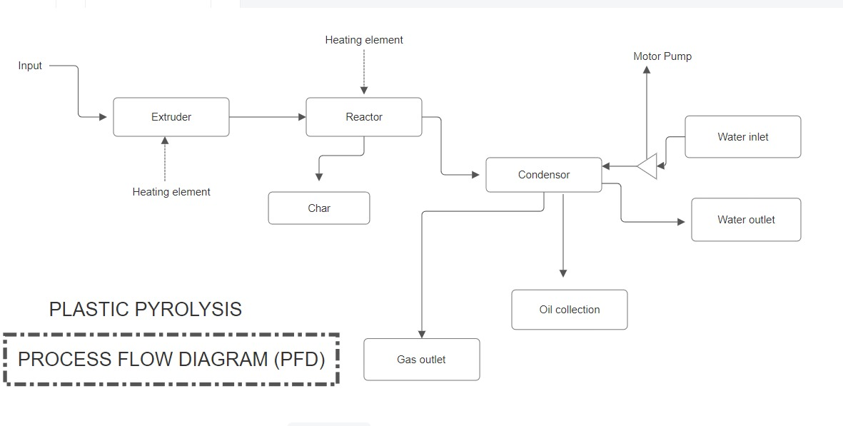
Process flow diagraM

Slide 9
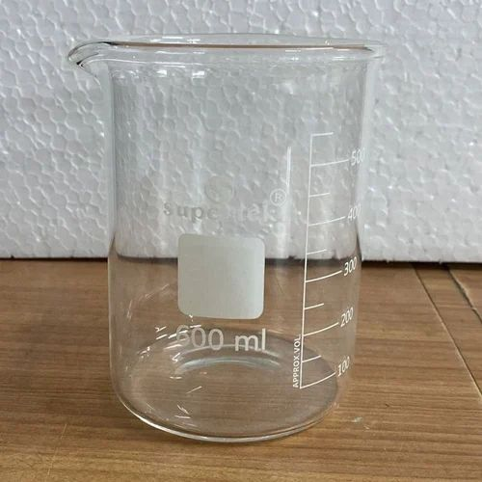
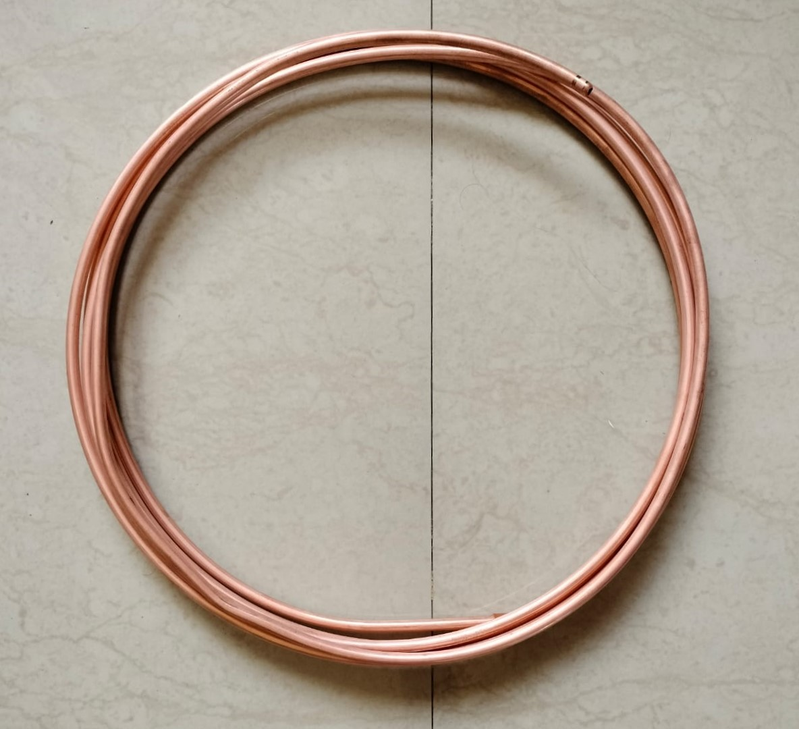
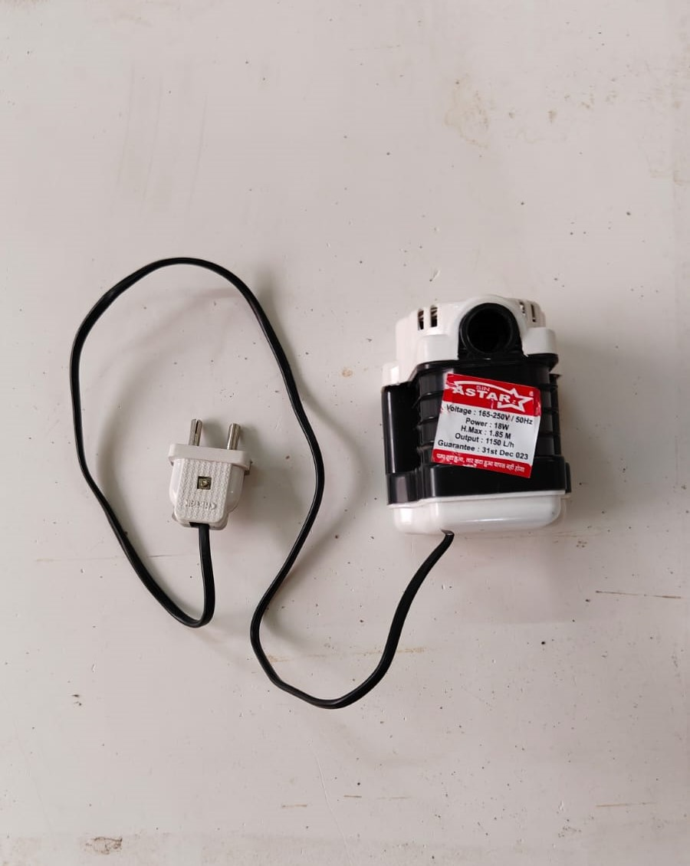
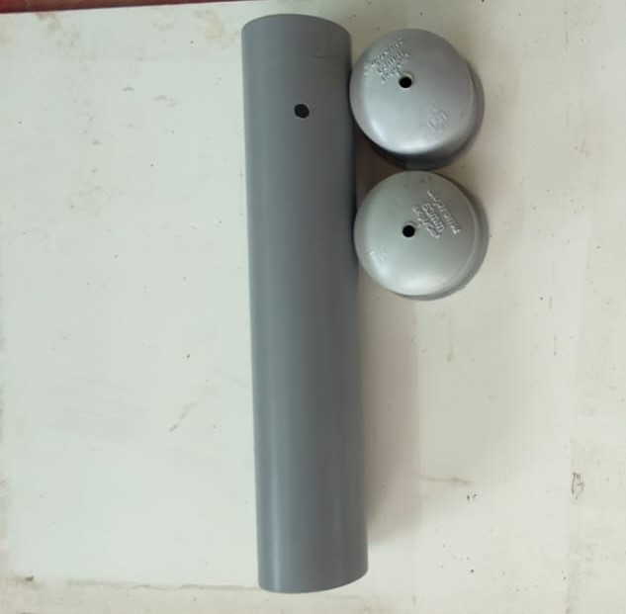
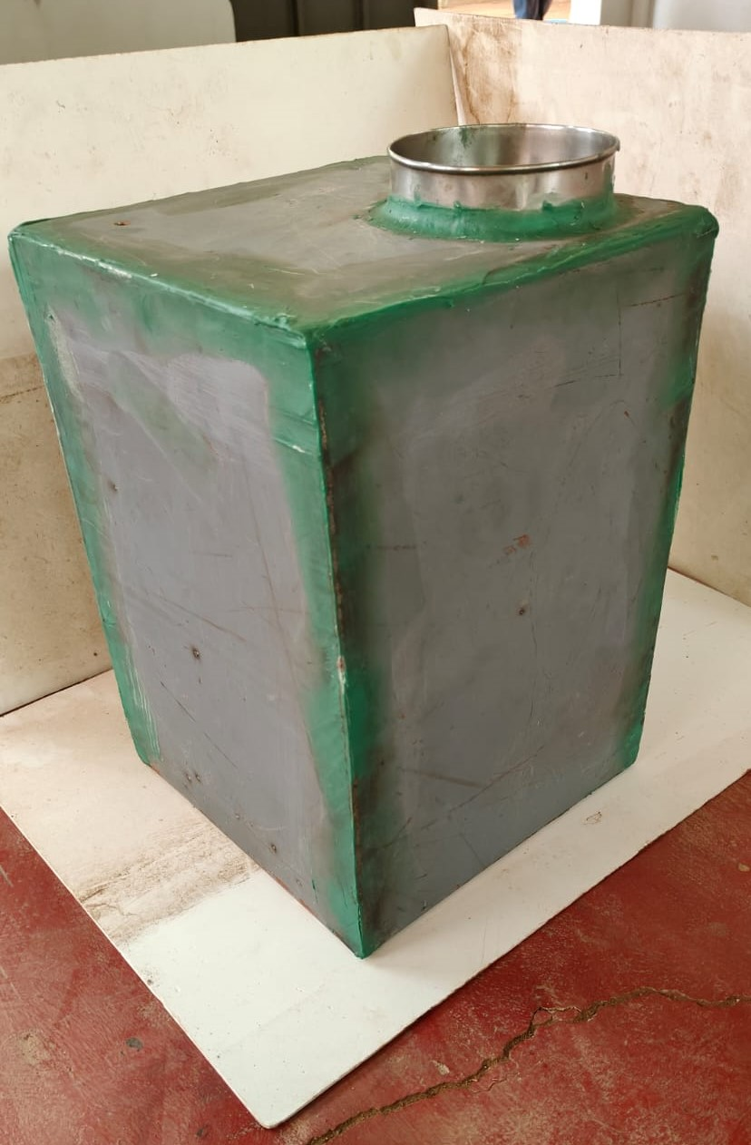
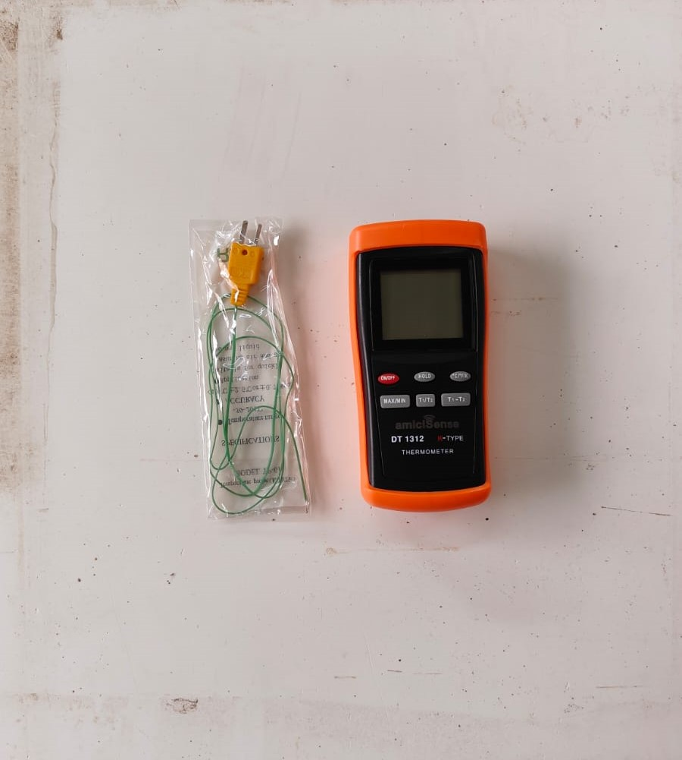
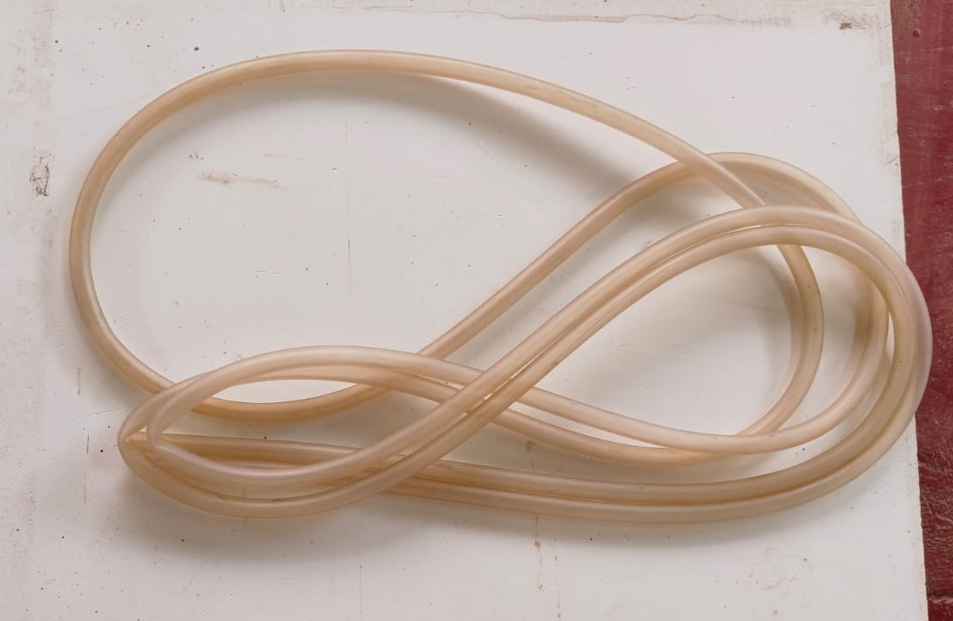
MATERIALS/APPARATUS used
1. Heating Plate.
2. Base Container (Vacuum sealed reactor).
3. Copper pipes.
4. PVC Pipes (Used for Double Condensers).
5. Silicon Tubes.
6. Collection Container.
7. Water Pumps.
8. Temperature indicator (Thermocouple).

Slide 10
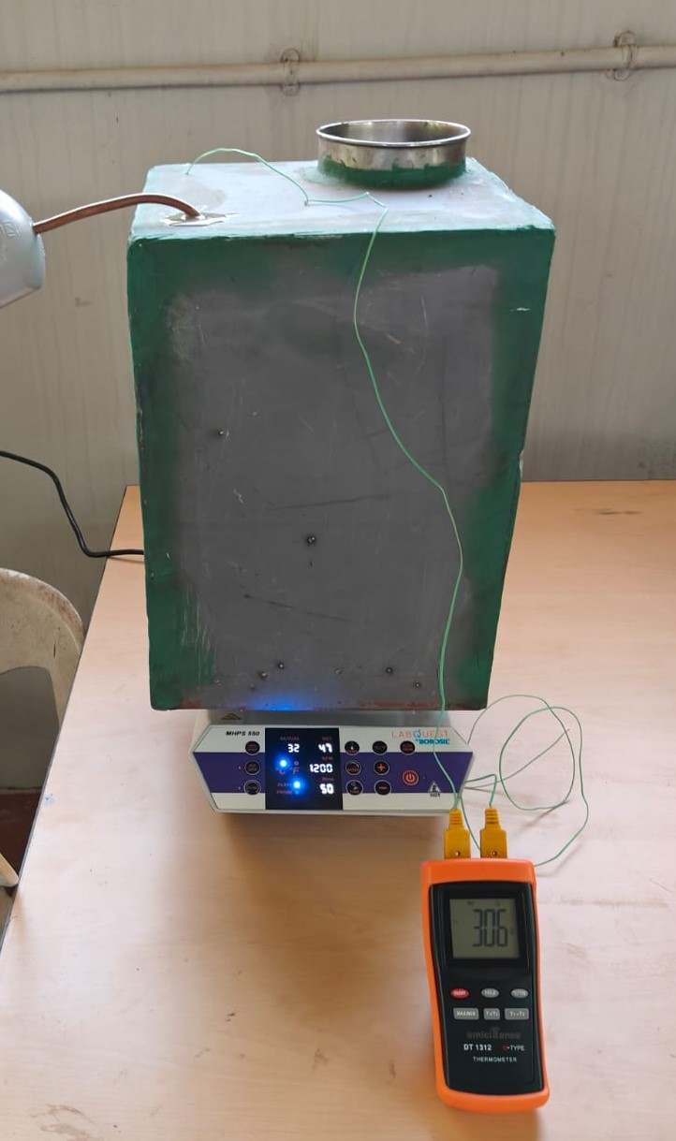
Reactor Construction
Reactor is made using MS Steel the major reasons behind using it are:
Strength: Mild Steel has a moderate tensile strength, making it suitable for a wide range of applications.
Weldability: MS steel is easily weldable, making it suitable for various fabrication processes.
Machinability: Mild Steel can be machined and formed with ease.
Welding: Mild Steel is well-suited for welding using various methods such as arc welding, MIG welding, and TIG welding.
Machining: Can be machined easily, but cutting tools need to be kept sharp due to its softness.

Slide 11
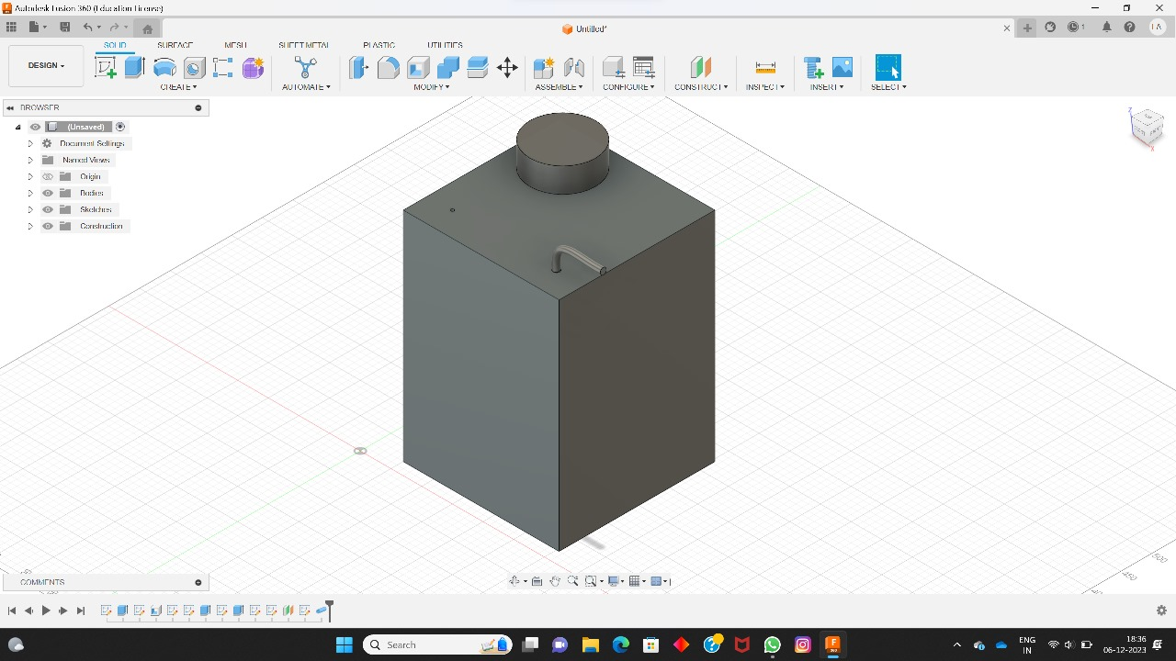
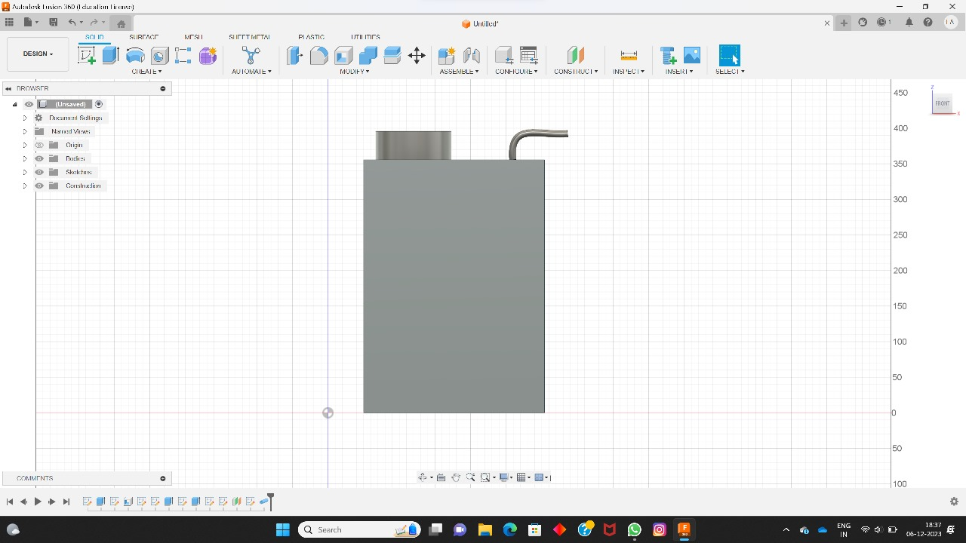
CAD DIAGRAMS
REACTOR

Slide 12
Double Condenser
Enhanced product quality:
By using a double condenser, it is possible to achieve a more thorough condensation of the pyrolysis gases. This can result in a higher-quality liquid product, with reduced impurities and improved characteristics.
Increased processing capacity:
With a double condenser setup, the cooling capacity can be increased, allowing for higher throughput and processing capacity. This can be beneficial for scaling up the plastic pyrolysis operation.
Increased condensation efficiency:
The double condenser setup allows for better cooling and condensation of pyrolysis gases. This can increase the overall condensation efficiency and improve the yield of valuable liquid products.
Improved energy recovery:
The double condenser setup enables better heat exchange between the hot pyrolysis gases and the cooling medium, allowing for more efficient energy recovery. This can help in reducing the energy consumption of the process.

Slide 13
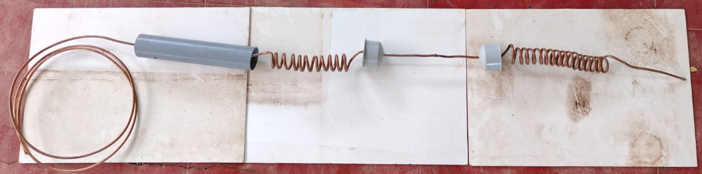
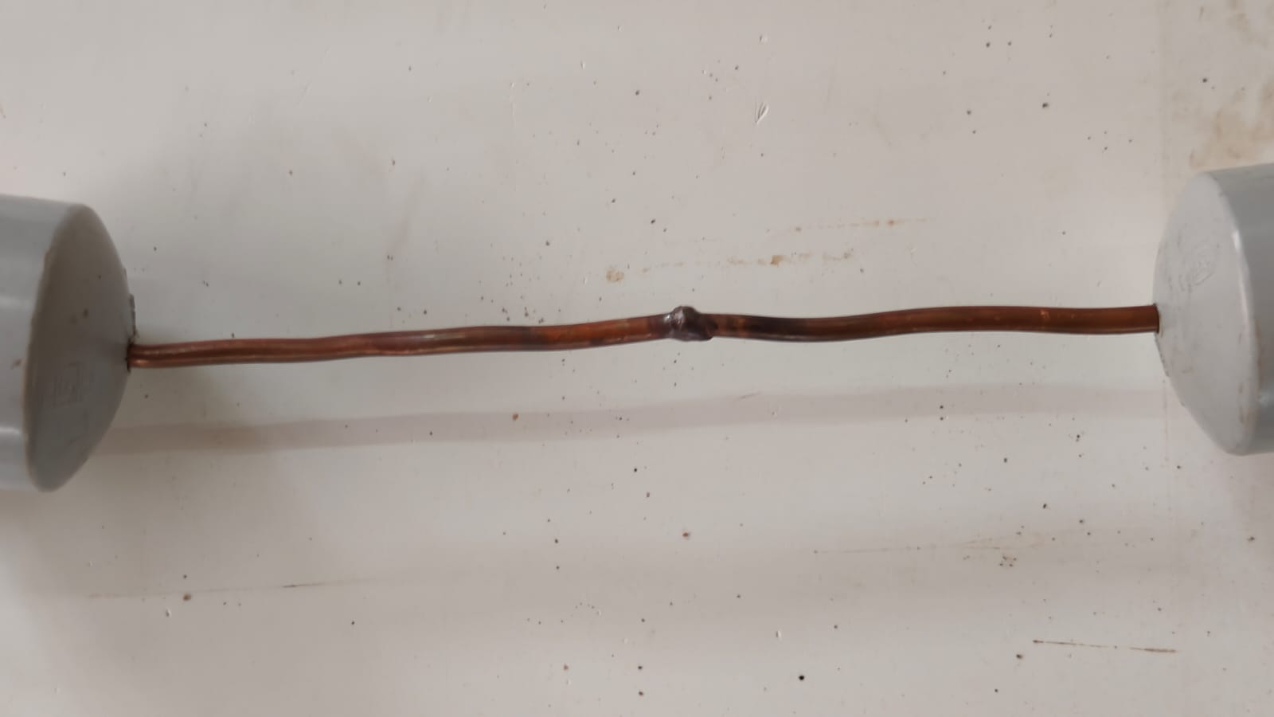
DOUBLE CONDENSER SETUP
Gas welding of two condensers

Slide 14
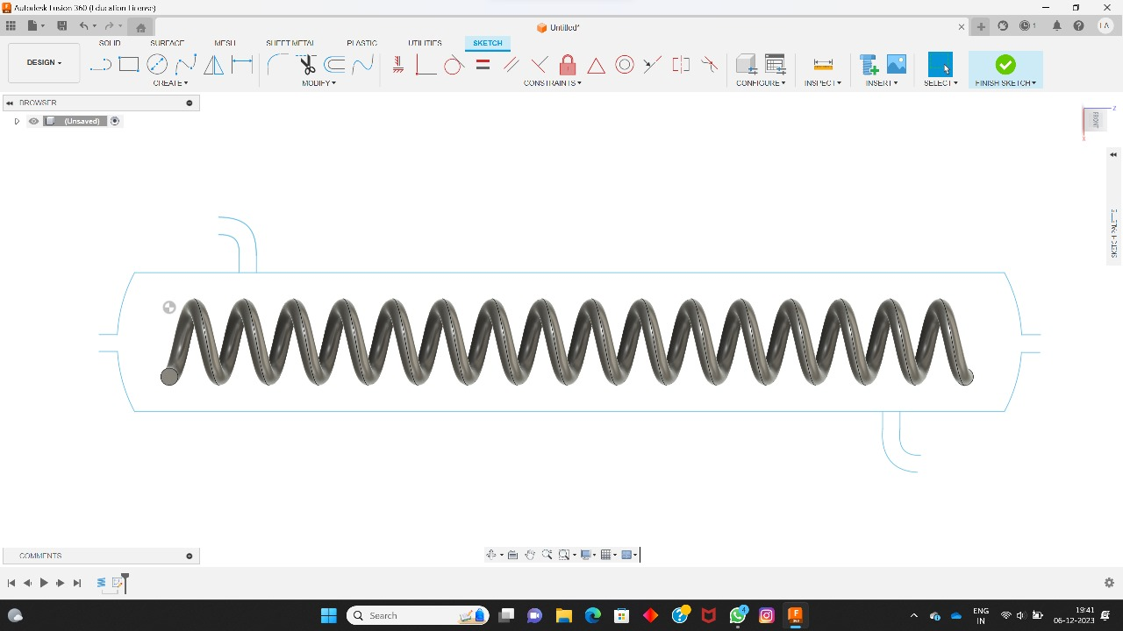
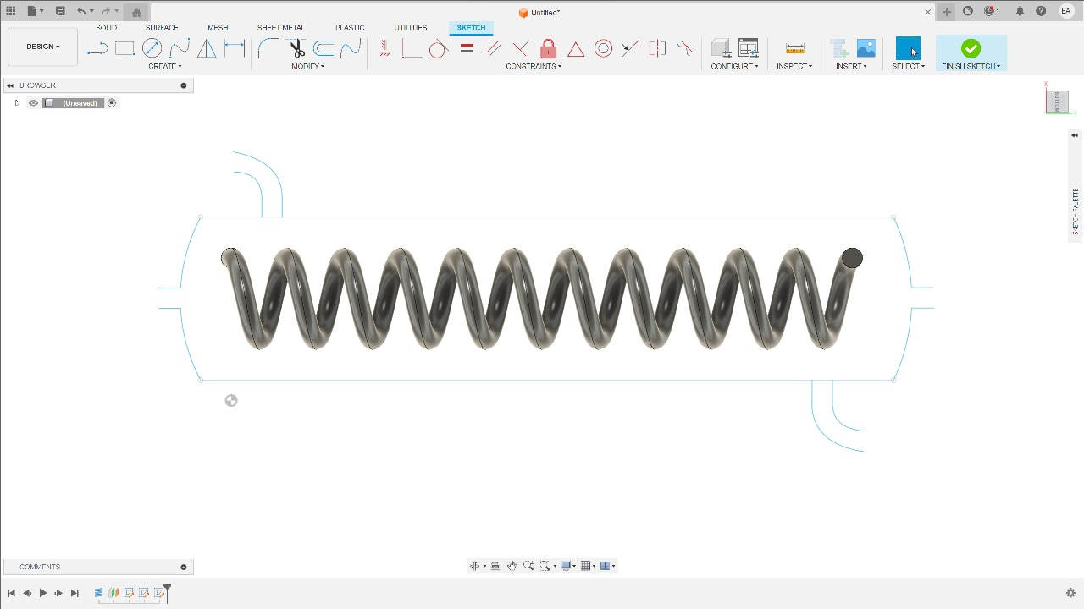
CAD DIAGRAMS
CONDENSER

Slide 15
Condenser material
Excellent Thermal Conductivity: Copper exhibits excellent thermal conductivity, making it an ideal choice for condensers. It efficiently transfers heat from the hot refrigerant vapor to the surrounding environment, allowing for effective heat exchange and condensation.
High Corrosion Resistance: Copper has a high resistance to corrosion, making it well-suited for condenser applications. It can withstand exposure to various environments and fluids without deteriorating or losing its performance over time. This resistance to corrosion helps ensure the longevity and reliability of the condenser.
Formability and Versatility: Copper is highly formable, allowing for the manufacturing of condensers in various shapes and sizes. It can be easily bent, shaped, or soldered to meet specific design requirements, making it a versatile material for condenser fabrication.
Efficient Heat Transfer: Copper's superior thermal conductivity allows for efficient heat transfer, resulting in enhanced condensation performance. This leads to improved energy efficiency and better cooling capacity of the condenser unit.

Slide 16
THERMOCOUPLE
The integration of thermocouple stands as a fundamental aspect in monitoring temperature. The temperature sensors play a pivotal role in precisely detecting and monitoring temperature variations, offering a means to gauge the conditions within the reactor. The application of thermocouples is grounded in the Seebeck effect.
The thermocouple system implemented in our project encompasses two sensors—one positioned inside the reactor and another recording external temperatures. The disparity between these measurements provides insights into the vapor temperature within the reactor. The ability to discern this temperature gradient is crucial for optimizing pyrolysis processes.
Key features of thermocouples employed in this context include their capability for accurate temperature measurement, covering a wide temperature range. Their compact size and simple construction contribute to the practicality of implementation, ensuring a rapid response to changes in temperature.
The voltage generated by the thermocouple is a direct consequence of the temperature difference between the hot and cold junctions. By precisely determining the temperature at the cold junction, the system can compensate for this known temperature, enabling accurate measurement of the temperature at the hot junction within the reactor

Slide 17
Working Mechanism
Feeding: Plastic waste is fed into the pyrolysis reactor, where it undergoes thermal decomposition in the absence of oxygen. The reactor is typically heated to high temperatures, ranging from 300 to 500 degrees Celsius.
Pyrolysis: As the plastic waste is heated, it undergoes pyrolysis, breaking down into pyrolysis gases. These gases mainly consist of hydrocarbons, such as methane, ethane, propane, and other volatile organic compounds.
Gas Cooling: The pyrolysis gases are then passed through the first condenser, which is responsible for cooling them down. The first condenser utilizes a cooling medium, such as water or air, to remove heat from the gases. As a result, the gases undergo condensation and transform into a liquid state.
Liquid Collection: The condensed liquid from the first condenser is collected and typically separated into various fractions, such as fuel oil, carbon black, and gas. These fractions can be further processed and utilized for different applications.

Slide 18
Gas Cooling (Second Condenser): The remaining gases, not condensed in the first condenser, continue to the second condenser for further cooling. The second condenser operates similarly to the first condenser, using a cooling medium to extract more heat from the gases.
Further Liquid Collection: The gases that pass through the second condenser undergo additional condensation, resulting in more liquid products. These additional liquid products are also collected and processed separately.
Gas Treatment: The gases that are not condensed in either condenser are typically directed to a gas treatment system. This system may involve processes such as scrubbing, filtering, or catalytic conversion to remove impurities and pollutants.
Gas Utilization: The treated gases can be further utilized for energy generation within the pyrolysis process itself. They can be burned as fuel to provide heat for the reactor or other operations in the pyrolysis plant.

Slide 19
FEEDSTOCK
PP (Polypropylene)
Properties: PP is a thermoplastic polymer with a high melting point, excellent chemical resistance, and good mechanical strength. It is commonly used in packaging, automotive parts, textiles, and various household products.
Pyrolysis Process: When subjected to pyrolysis, PP undergoes thermal decomposition in the absence of oxygen. The process breaks down the polymer chains into smaller hydrocarbon molecules, resulting in the production of pyrolysis gases, liquid fuel oil, and solid residue.
Pyrolysis Products: The pyrolysis of PP typically yields a higher proportion of liquid fuel oil compared to other feedstocks. The fuel oil can be further refined and used as a substitute for fossil fuels. The solid residue, known as char or coke, can be used as a solid fuel or processed for other applications.

Slide 20
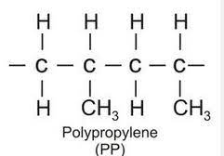
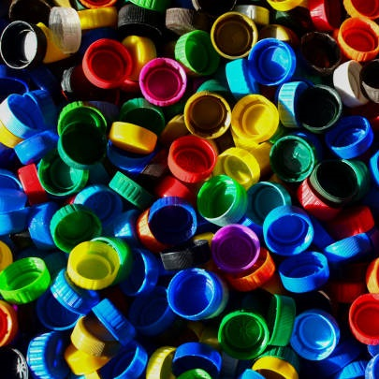
Reaction Kinetics: The pyrolysis of PP involves a complex set of reactions, including thermal cracking, chain scission, and secondary reactions. The kinetics of these reactions can be influenced by factors such as temperature, residence time, and the presence of catalysts.
Liquid Fuel Oil: The liquid fraction obtained from PP pyrolysis is commonly referred to as fuel oil or pyrolysis oil. It is a mixture of hydrocarbons and can be further refined to produce valuable fuels or chemical feedstocks.

Slide 21
PET (Polyethylene terephthalate)
Properties: PET is a strong, lightweight, and versatile thermoplastic polymer. It is commonly used in beverage bottles, food containers, textiles, and synthetic fibers.
Pyrolysis Process: PET can be pyrolyzed in a similar manner to other plastics. The process involves subjecting PET to high temperatures in the absence of oxygen, leading to the breakdown of the polymer chains into smaller molecules.
Pyrolysis Products: The pyrolysis of PET typically yields a range of products including liquid fuel oil, gases, and solid residue. The liquid fuel oil can be further processed and used as a fuel source or as a feedstock for refining processes. The gases produced can be treated and utilized for energy generation within the pyrolysis plant. The solid residue, similar to other feedstocks, can be used as a solid fuel or processed for other applications.

Slide 22
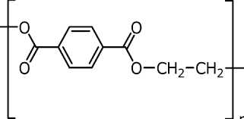
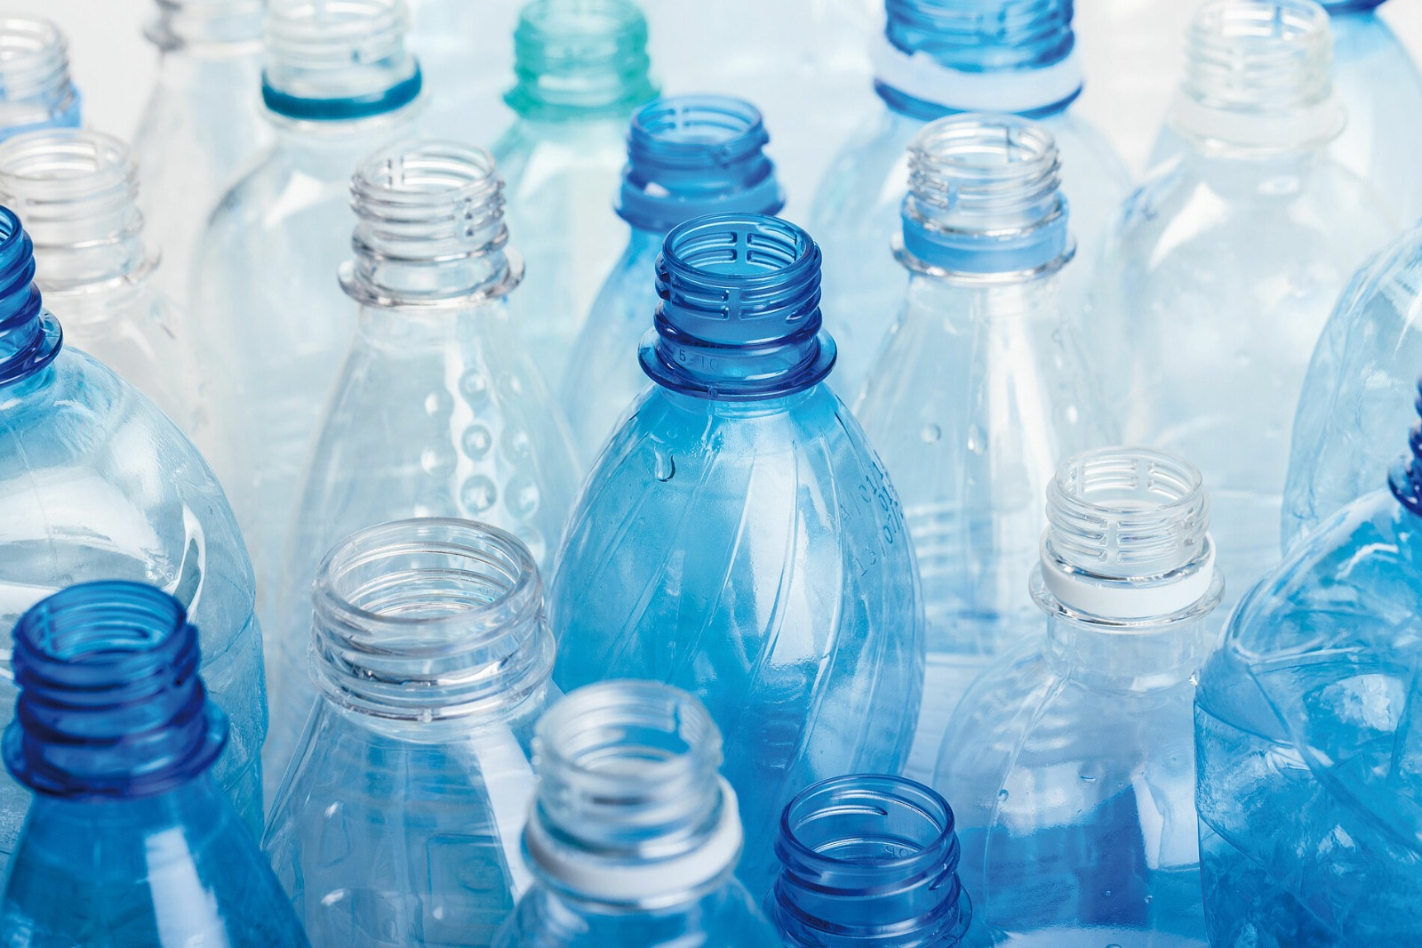
Reaction Kinetics: The pyrolysis of PET involves thermal degradation and depolymerization reactions. These reactions break down the polymer chains into smaller hydrocarbon molecules. The kinetics of these reactions can be influenced by parameters such as temperature, residence time, and the presence of catalysts.
Liquid Fuel Oil: The liquid fraction obtained from PET pyrolysis is commonly referred to as pyrolysis oil or fuel oil. It contains a mixture of hydrocarbons that can be further refined and used as a substitute for fossil fuels or as a feedstock for chemical processes.

Slide 23
Characteristics of feedstock
PLASTIC TYPE | TEMPERATURE | MELTING POINT | DENSITY
HDPE LDPE PET PP | 300℃ - 400℃ 350℃ - 600℃ 500℃ 300℃ - 700℃ | 120℃ - 160℃ 110℃ - 115℃ 250℃ - 260℃ 160℃ - 166℃ | 0.97 g/cm^3 0.940 g/cm^3 1.38 g/cm^3 0.92 g/cm^3
Plastic types, such as HDPE, LDPE, PET, and PP, have different temperature ranges, melting points, and densities.
HDPE has a melting point of 120℃ - 160℃ and a density of 0.97 g/cm^3, while LDPE has a melting point of 110℃ - 115℃ and a density of 0.940 g/cm^3.
PET has a melting point of 250℃ - 260℃ and a density of 1.38 g/cm^3, and PP has a melting point of 160℃ - 166℃ and a density of 0.92 g/cm^3.
These variations in properties make each plastic type suitable for different applications based on factors such as strength, flexibility, chemical resistance, and recyclability.

Slide 24
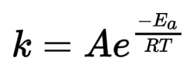
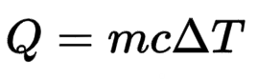
PYROLYSIS KINETICS
Pyrolysis is a process where organic materials are heated in the absence of oxygen, leading to decomposition. The main equations involve the chemical reactions during pyrolysis.
1. Arrhenius Equation : 2. Heat flow :
k = rate constant ,
A= pre-exponential factor
e = Activation Energy
R= Universal Gas Content
T= Absolute temperature (in Kelvin)
Q = Heat energy
m = Mass of substance
c = Specific Heat capacity
ΔT = Change in temperature

Slide 25
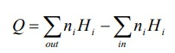

Overall energy Equation:
Q = overall energy required in the pyrolysis process (kJ)
Ni = molar number of component i (mol)
Hi = enthalpy of component i (kJ/mol)
Energy balance analysis:
This part of work aims to quantify the energy changes throughout the pyrolysis process thus the net energy input or
Output can be quantified. dQ/dt = rate of heat transfer
k = thermal conductivity
A = area perpendicular to direction of heat transfer, x
dT/dx = temperature gradient in direction x

Slide 26
ADVANTAGES AND DISADVANTAGES OF PYROLYSIS
ADVANTAGES:
Reducing Plastic Waste: It provides a way to convert plastic waste that would otherwise end up in landfills or oceans into valuable products.
Resource Recovery: Pyrolysis can be used to convert various organic materials, including biomass, waste plastics, and rubber, into valuable products such as biochar, bio-oil, and syngas.
Energy Generation: Pyrolysis can be employed to produce bioenergy in the form of bio-oil and syngas, which can be used as fuels for heat and power generation. This can contribute to renewable energy production and reduce dependence on fossil fuels.
Biochar Production: The solid residue obtained from pyrolysis, known as biochar, can be used as a soil amendment to improve soil fertility, structure, and carbon sequestration. This has potential benefits for agriculture and carbon sequestration.
Chemical Production: Some of the products from plastic pyrolysis can be used as feedstock for chemical manufacturing.
Versatility: Pyrolysis can be applied to a wide range of feedstocks, including biomass, plastics, rubber, and other organic materials, making it a versatile technology for waste management and resource recovery.

Slide 27
DISADVANTAGES:
Energy Intensive: Pyrolysis processes often require high temperatures, making them energy-intensive. The energy input needed to initiate and sustain the pyrolysis reaction can be significant, impacting the overall efficiency of the process.
Complexity of Feedstock: The type and composition of the feedstock significantly affect the pyrolysis process. The presence of contaminants or heterogeneous materials in the feedstock can complicate the process and may require additional pre-processing steps.
Emissions: While pyrolysis is considered a more environmentally friendly option compared to some other waste disposal methods, it still produces emissions. Gaseous byproducts, such as volatile organic compounds (VOCs), may be released during the process, and careful management is required to minimize environmental impact.
Economic Viability: The capital costs associated with establishing pyrolysis facilities, along with operating costs and market uncertainties for the resulting products, may impact the overall feasibility of the technology. .
Scale-up Challenges: Scaling up pyrolysis processes from laboratory or pilot scale to commercial scale can pose challenges. Factors such as heat transfer, reactor design, and process control become more complex as the scale increases.

Slide 28
ECONOMIC AND ENVIRONMENTAL IMPACT
ECONOMIC IMPACTS
Resource Recovery and Valorization: Pyrolysis can contribute to resource recovery by converting waste materials, such as biomass and plastics, into valuable products like biochar, bio-oil, and syngas.
Energy Production: Pyrolysis produces bioenergy in the form of bio-oil and syngas, which can be used for heat and power generation. This can contribute to energy security and provide an alternative to conventional energy sources.
Waste Management Savings: Pyrolysis can reduce the volume of organic waste going to landfills, potentially lowering waste management costs for municipalities and businesses.
Market for Pyrolysis Products: The economic viability of pyrolysis is closely tied to the market demand and prices for the produced products (biochar, bio-oil, etc.). Market conditions and competition can influence the profitability of pyrolysis ventures.
Government Incentives: Government incentives and policies, such as tax credits or subsidies for renewable energy production, can positively impact the economic feasibility of pyrolysis projects. Conversely, regulatory constraints may increase operational costs.
Capital and Operational Costs: The capital investment and operational costs associated with pyrolysis technologies can be significant. Advances in technology and economies of scale may help reduce costs over time.

Slide 29
ENVIRONMENTAL IMPACTS
Greenhouse Gas Emissions: Pyrolysis can help mitigate greenhouse gas emissions by converting organic materials into biochar, which sequesters carbon in the soil. However, the combustion of pyrolysis products (e.g., bio-oil) can release CO2, and emissions depend on the feedstock and process conditions.
Land Use and Soil Quality: The use of biochar produced from pyrolysis as a soil amendment can improve soil fertility and carbon sequestration, positively impacting agricultural practices.
Water Usage: Some pyrolysis processes may require water for cooling or other purposes. The environmental impact depends on the source of water and the efficiency of water usage.
Biomass and Land Competition: Depending on the feedstock used, there could be competition with food crops or natural ecosystems for land use. Sustainable sourcing practices are crucial to mitigate this impact.
Ecological Effects: The extraction or cultivation of feedstocks for pyrolysis can have ecological impacts, especially if not managed sustainably. Consideration of biodiversity and ecosystem services is important.
Contaminant Removal: The presence of contaminants in feedstocks, such as plastics, may pose challenges for environmental sustainability. Effective contaminant removal processes are essential.

Slide 30
CONCLUSION
The design of a plastic pyrolysis setup presents a promising approach for addressing plastic waste management challenges. This project has explored the key aspects involved in the design process, including feedstock selection, reactor configuration, operating conditions, and product recovery. The proposed design offers a robust and scalable solution for converting plastic waste into valuable products such as fuels, chemicals, and char.
Key findings of this study include:
Plastic pyrolysis offers a viable method for diverting plastic waste from landfills and generating valuable resources.
The selection of the appropriate feedstock and reactor configuration significantly impacts the efficiency and product yield of the process.
Careful control of operating conditions, such as temperature and heating rate, is crucial for optimizing the pyrolysis process.
Effective product recovery systems are essential for capturing and utilizing the valuable products generated during pyrolysis

Slide 31
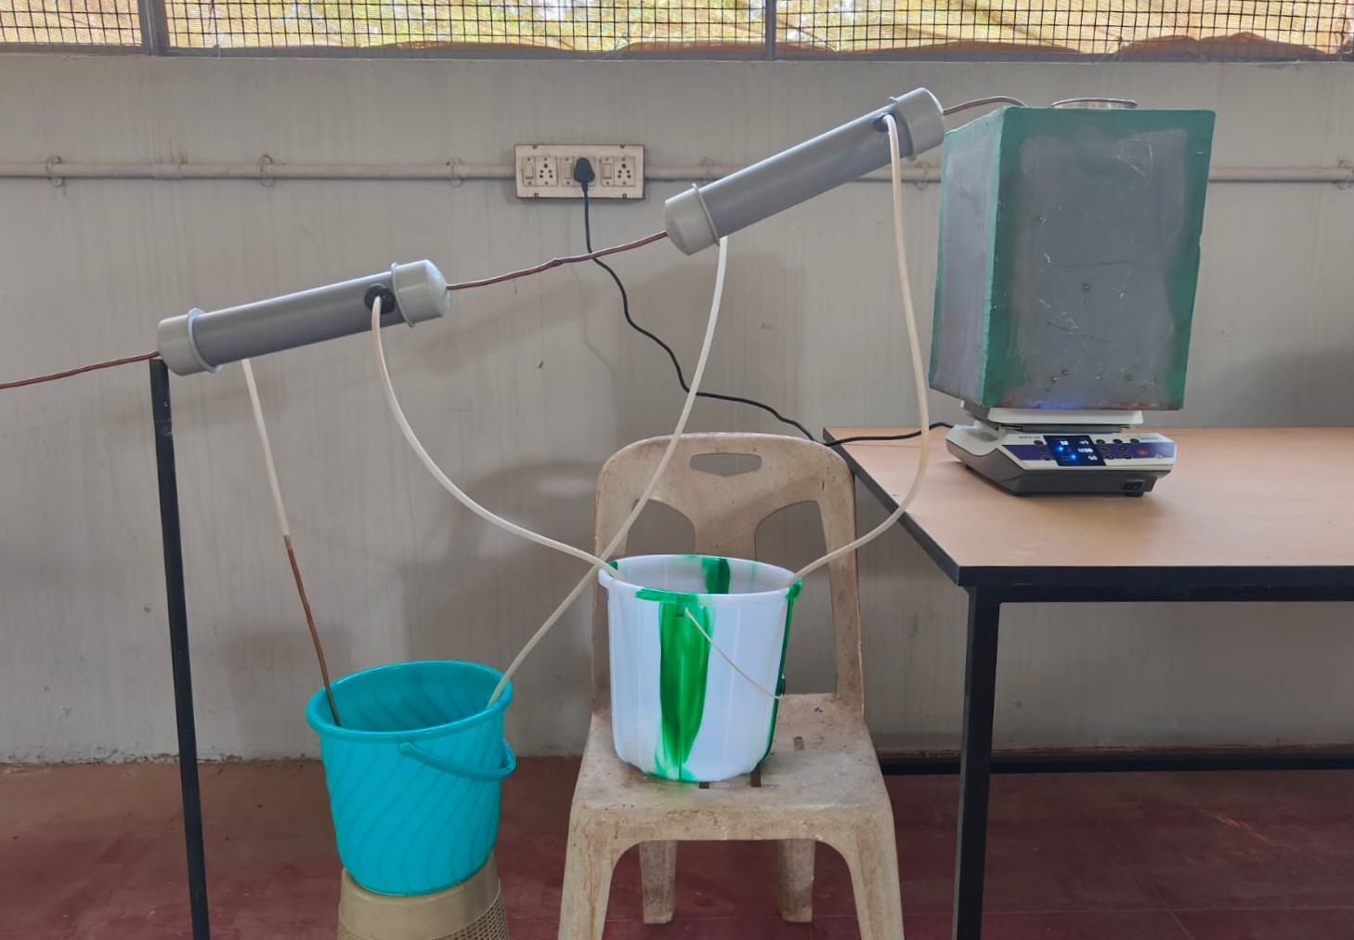
DESIGN OF PLASTIC PYROLYSIS SETUP

Slide 32
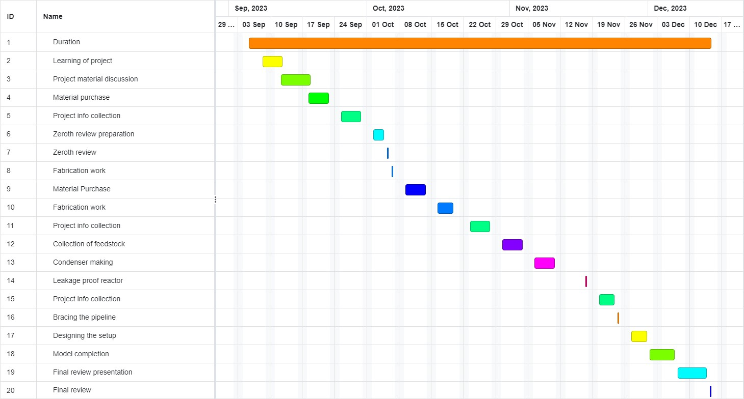
Timeline

Slide 33
FUTURE ENHANCEMENTS
Energy Efficiency Improvements: Research and development efforts can focus on optimizing pyrolysis processes to reduce energy input requirements and increase overall energy efficiency.
Process Modeling and Control: Improved understanding of the complex reaction mechanisms and better process modeling can aid in precise control of pyrolysis processes, enabling more consistent product yields and composition.
Advanced Reactor Design: Innovative reactor designs, such as fluidized bed reactors or rotating cone reactors, can enhance heat and mass transfer, leading to more efficient and scalable pyrolysis systems
Product Upgrading Technologies: Research into upgrading the pyrolysis products, such as bio-oil, can improve their quality, stability, and compatibility with existing infrastructure, thereby expanding their market potential
Catalyst Advancements: Research on catalyst development can lead to more efficient and stable catalysts, reducing dependency and associated costs while improving reaction rates and product yields.

Slide 34
REFERENCES
Moses Jeremiah Barasa Kabeyi and Oludolapo Akanni Olanrewaju "Review and Design Overview of Plastic Waste-to-Pyrolysis Oil Conversion with Implications on the Energy Transition " ,Industrial Engineering Department, Durban University of Technology, Durban,South Africa https://www.hindawi.com/journals/jen/2023/1821129/
Moses Jeremiah Barasa Kabeyi ,Oludolapo Olanrewaju Durban University of Technology "Review and Design Overview of Plastic Waste-to-Pyrolysis Oil Conversion with Implications on the Energy Transition“ https://www.researchgate.net/publication/370969559_Review_and_Design_Overview_of_Plastic_Waste-to Pyrolysis_Oil_Conversion_with_Implications_on_the_Energy_Transition
Arizal Aswan, Irawan Rusnadi, Fatria, Zurohaina, Rima Daniar Department of Chemical Engineering, Polytechnic of Sriwijaya, Palembang, Indonesia "Re-Design Pyrolysis Reactor Prototype for the Conversion of Plastic Waste into Liquid Fuel" https://iopscience.iop.org/article/10.1088/1742-6596/1500/1/012061/pdf

Slide 35
4. Center For Biorefining And Department Of Bioproducts And Biosystems Engineering, University Of Minnesota, 1390 Eckles Ave., St. Paul MN 55108, United States "Pyrolysis Technology For Plastic Waste Recycling: A State-of-the-art Review"
Https://Www.Sciencedirect.Com/Science/Article/Abs/Pii/S0360128522000302
5. Antonio Espuna, Department Of Chemical Engineering, Universitat Politècnica De Catalunya, Campus Diagonal-besòs, Barcelona, Spain "Economic And Environmental Assessment Of Plastic Waste Pyrolysis Products And Biofuels As Substitutes For Fossil-based Fuels "https://Www.Frontiersin.Org/Articles/10.3389/Fenrg.2021.676233/Full
6. VSRS Sarma Salagrama, "Studies On Fire Pyrolysis And Modeling For Plastics“, department Of Chemical Engineering, Indian Institute Of Technology Roorkee - 247887(India) June 2012.
7. Feng Gao, "Pyrolysis Of Waste Plastic Into Fuels", University Of Canterbury 2010.

Slide 36
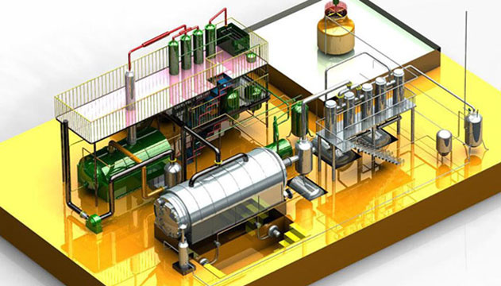
THANK YOU

